Slide 1
1DT057
DISTRIBUTED INFORMATION SYSTEM
Distributed Systems
Characterization and Design
Notes:
The questions that we try to answer this lecture are:
What is a distributed system, why should we bother to construct systems in a distributed fashion and what are the key properties of a distributed system?

Slide 2
OUTLINE
1. What is a Distributed System
2. Examples of Distributed Systems
3. Common Characteristics
4. Basic Design Issues
5. Summary
Notes:
In the first part we shall attempt a definition of the term distributed system and compare it to centralized systems.
For a better appreciation of the issues that are involved in distributed systems, we will review several distributed systems that everybody in this class has come across (probably without recognizing that this is a distributed system)
We shall then elaborate on the common characteristics of distributed systems. These can be used to assess and compare distributed systems. They will also provide us with (initial) guidelines as to what we should remember when we construct distributed systems.
A summary will repeat what you should remember from this weeks lecture.

Slide 3
1. DISTRIBUTED SYSTEM TYPES
Fully
Distributed
Control
Data
Autonomous
fully cooperative
Local data,
local directory
Autonomous
transaction based
Not fully replicated
master directory
Master-slave
Fully replicated
Homog.
special
purpose
Homog.
general
purpose
Processors
Heterog.
special
purpose
Heterog.
general
purpose
Notes:
Systems involve hardware (processors), application and system software (control) and application and system information (data).
Which of these dimensions have to be distributed for the system to be a distributed system?
Enslow requires that distribution is transparent and system users are unaware of the fact that the system is composed of multiple processors.
Enslow´s model (1978) is fairly rigid: A system is a fully distributed system if and only if all dimensions are fully decentralized.
Full hardware decentralization includes multiple heterogeneous control units (as opposed to a single control unit with multiple processors and multiple homogeneous control units).
Control must be provided by multiple units cooperating with each other rather than in a master-slave relationship
Data must be partitioned and/or replicated, each part with its own local directory.
Enslow´s definition is too restrictive in our opinion. Techniques of distributed system construction should also be employed if only a single dimension is decentralized.

Slide 4
1. WHAT IS A DISTRIBUTED SYSTEM?
Definition: A distributed system is one in which components located at networked computers communicate and coordinate their actions only by passing messages.
or
A distributed system contains multiple nodes that are physically separate but linked together using the network.
This definition leads to the following characteristics of distributed systems:
Concurrency of components
Lack of a global ‘clock’
Independent failures of components
Notes:
We employ the (adapted) definition of Colouris, Dollimore and Kindberg (2005) of a distributed system.
It requires autonomous computers to be interconnected through a network.
Each computer has to be equipped with distributed operating system software, which enables the computers to coordinate activities and to share resources in a controlled way
We also require transparency of distribution for the computer users. They shall not have to be aware of the fact that the system is distributed.

Slide 5
1.1 CENTRALIZED SYSTEM CHARACTERISTICS
One component with non-autonomous parts
Component shared by users all the time
All resources accessible
Software runs in a single process
Single point of control
Single point of failure
Notes:
To clarify the consequences of distributing a system, we compare its characteristics to those we find in centralized systems.
In a centralized system, there is a single component that may be decomposed further. However, its parts (such as classes in an object-oriented program) are not autonomous, i.e the component possess full control over them at all times. As there are no other components, there is no need to provide an interface to the component.
If the component supports multiple users (e.g. a relational database), the users share the complete component at all times.
A centralized system runs in a single process. There is no need to take concurrency control and synchronization into account.
There is only a single point of control. The component is in exactly one state that is determined by the program counter of the processor, register variable contents and the virtual memory occupied by the process.
Either the system is running or it is not.Situations cannot occur where part of the system or parts of its interconnection have failed and need to recover.

Slide 6
1.2 DISTRIBUTED SYSTEM CHARACTERISTICS
Multiple autonomous components
Components are not shared by all users
Resources may not be accessible
Software runs in concurrent processes on different processors
Multiple points of control
Multiple points of failure
Notes:
In a distributed system, there are multiple components that may be decomposed further. These components are autonomous, i.e. they possess full control over their parts at all times. The components, however, have to provide interfaces to be able to use each other.
There may be components that are used by only some users but are not used by others. It is then beneficial to have these components residing on machines that are local to the users that use them.
A distributed system runs in multiple processes. These processes are usually not executed on the same processor. Hence inter-process communication involves communication with other machines through a network. Different levels of abstraction (confer the ISO/OSI reference model) are involved in this communication.
There are multiple points of control, but these are not totally independent. Components have to take into account that they are being used by other components and have to react properly to requests.
There are multiple points of failure in a distributed system. The system may fail because a component of the system has failed. It may also fail if the network has broken down. It may also fail if the load on a component is so high that it does not respond within a reasonable time frame. Even so, the distributed system is more fault-tolerant than a centralized one.

Slide 7
MULTIPLE AUTONOMOUS COMPONENTS
A distributed system is a collection of autonomous computing elements that appears to its users as a single coherent system.
This definition refers to two characteristic features of distributed systems.
The first one is that a distributed system is a collection of computing elements each being able to behave independently of each other.
A computing element, which we will generally refer to as a node, can be either a hardware device or a software process.
A second element is that users (be they people or applications) believe they are dealing with a single system.
This means that one way or another the autonomous nodes need to collaborate.
How to establish this collaboration lies at the heart of developing distributed systems.

Slide 8
MULTIPLE AUTONOMOUS COMPONENTS
A fundamental principle is that nodes can act independently from each other, although it should be obvious that if they ignore each other, then there is no use in putting them into the same distributed system.
In practice, nodes are programmed to achieve common goals, which are realized by exchanging messages with each other.
A node reacts to incoming messages, which are then processed and, in turn, leading to further communication through message passing.

Slide 9
CONCURRENCY
Concurrency is a property of a system representing the fact that multiple activities are executed at the same time.
A program having "several independent activities, each of which executes at its own pace".
In addition, the activities may perform some kind of interaction among them.
The concurrent execution of activities can take place in different environments, such as single-core processors, multi-core processors, multi-processors or even on multiple machines as part of a distributed system.
Yet, they all share the same underlying challenges: providing mechanisms to control the different flows of execution via coordination and synchronization, while ensuring consistency.

Slide 10
CONCURRENCY
Apart from recent hardware trends towards multi-core and multiprocessor systems, the use of concurrency in applications is generally motivated by performance gains.
Three fundamental ways how the concurrent execution of an application can improve its performance:
  Reduce latency: A unit of work is executed in shorter time by subdivision into parts that can be executed concurrently.
  Hide latency: Multiple long-running tasks are executed together by the underlying system. This is particularly effective when the tasks are blocked because of external resources they must wait upon, such as disk or network I/O operations.
  Increase throughput: By executing multiple tasks concurrently, the general system throughput can be increased. It is important to notice that this also speeds up independent sequential tasks that have not been specifically designed for concurrency yet.

Slide 11
CONCURRENCY
The presence of concurrency is an intrinsic property for any kind of distributed system.
Processes running on different machines form a common system that executes code on multiple machines at the same time.
Conceptually, all web applications can be used by various users at the same time. Thus, a web application is also inherently concurrent.

Slide 12
CONCURRENCY VS. PARALLELISM
Concurrency is a conceptual property of a program, while parallelism is a runtime state.
Concurrency of a program depends on the programming language and the way it is coded, while parallelism depends on the actual runtime environment.
Given two tasks to be executed concurrently, there are several possible execution orders. They may be performed sequentially (in any order), alternately, or even simultaneously.
Only executing two different tasks simultaneously yields true parallelism.
In terms of scheduling, parallelism can only be achieved if the hardware architecture supports parallel execution, like multi-core or multi-processor systems do.
A single-core machine will also be able to execute multiple threads concurrently, however it can never provide true parallelism.

Slide 13
FOUR MAIN APPROACHES FOR PROGRAMMING CONCURRENCY
Sequential Programming
In this deterministic programming model, no concurrency is used at all. In its strongest form, there is a total order of all operations of the program. Weaker forms still keep the deterministic behaviour. However, they either make no guarantees on the exact execution order to the programmer a priori. Or they provide mechanisms for explicit preemption of the task currently active, as co-routines do, for instance.
Declarative Concurrency
Declarative programming is a programming model that favors implicit control flow of computations. Control flow is not described directly, it is rather a result of computational logic of the program. The declarative concurrency model extends the declarative programming model by allowing multiple flows of executions. It adds implicit concurrency that is based on a data-driven or a demand-driven approach. While this introduces some form of nondeterminism at runtime, the nondeterminism is generally not observable from the outside.
Message-passing Concurrency
This model is a programming style that allows concurrent activities to communicate via messages. Generally, this is the only allowed form of interaction between activities which are otherwise completely isolated. Message passing can be either synchronous or asynchronous resulting in different mechanisms and patterns for synchronization and coordination.
Shared-state Concurrency
Shared-state concurrency is an extended programming model where multiple activities are allowed to access contended resources and states. Sharing the exact same resources and states among different activities requires dedicated mechanisms for synchronization of access and coordination between activities. The general nondeterminism and missing invariants of this model would otherwise directly cause problems regarding consistency and state validity.

Slide 14
COMPUTER ARCHITECTURES SUPPORTING CONCURRENCY
This classification derives four different types of computer architectures, based on the instruction concurrency and the available data streams.
The SISD class is represented by traditional single processor machines. We do not consider them further due to their lack of physical concurrency.
MISD is a rather exotic architecture class, sometimes used for fault-tolerant computing where the same instructions are executed redundantly. It is also not relevant for our considerations. Real parallelism can only be exploited on architectures that support multiple data streams--SIMD and MIMD.
SIMD represents the aforementioned architecture class targeting dedicated parallel executions of computations such as graphics processing unit and vector processors.
SIMD exploits data-level parallelism which is not suitable for handling web requests.
MIMD represents architectures that rely on a shared or distributed memory and thus includes architectures possessing multiple cores, multiple CPUs or even multiple machines. on the MIMD class of architectures, we primarily focus on concurrent programming.

Slide 15
2. EXAMPLES OF DISTRIBUTED SYSTEMS
Local Area Network and Intranet
Database Management System
Automatic Teller Machine Network
Internet/World-Wide Web
Mobile and Ubiquitous Computing
Notes:
We now review several systems that most of you have come across already (possibly without being aware that they are distributed).
This review will provide you with a better understanding of the issues that are to be tackled during distributed systems construction.

Slide 16
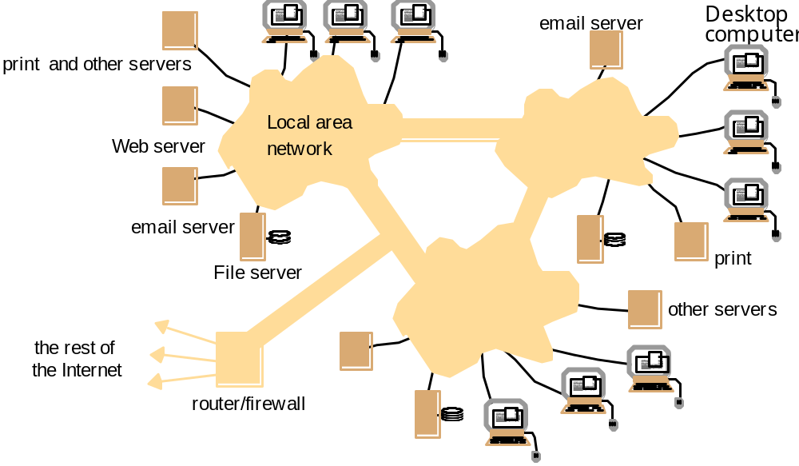
2.1 LOCAL AREA NETWORK
Notes:
A local area network consists of a number of different computers. Workstations and Personal computers provide the front-end for network users. Different servers provide shared services.
One or several network file servers provide data storage services. Any workstation and PC may henceforth store files on disks maintained by these file servers.
A local name server maps machine names to IP addresses, user names to user ids and group names to group ids. Any machine can request a service to resolve a certain name.
One or several print servers control the access to shared printers.Workstations and PCs have the server printing jobs for them.
Another component provides a gateway to the wide area network.
As a user you need not be aware which machine provides which service.
Name servers provide the information regarding machine (by IP address), user names (by user ids), and group name (by group ids).
Local area networks can be connected together to form Intranets.

Slide 17
LOCAL AREA NETWORK AND INTRANET
LAN consists of a computer network at a single site, typically and individual office building.
A LAN is very useful in for sharing resources such as data storage and printers.
LAN can be built with relatively inexpensive hardware, such as hubs, network adapters and Ethernet.
A LAN typically relies mostly on wired connections for increased speed and security, but wireless connections can also be part of LAN.
High speed and relatively low cost are the defining characteristics of LANs.
LANs are used from single sites where people need to share resources among themselves but not with the rest of outside world on a central server.

Slide 18
CHARACTERISTICS OF LAN IN DISTRIBUTED SYSTEMS
LAN is an example of a distributed system. It sits between workstations and fileservers.
Characteristics of LAN in distributed systems:
  1.Personal workstations and processors are not assigned to specific users
  2.Single file system, with all files accessible from all machines in the same way and using the same path name.
  3.For a certain command the system can look for the best place (workstation) to execute it

Slide 19
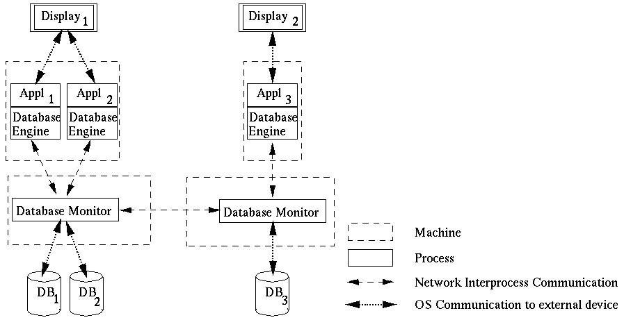
2.2 DATABASE MANAGEMENT SYSTEM
Notes:
Different client applications want to access and update shared data in a database.
Client applications might be banking systems, real-estate agencies, airline-ticket reservation systems accessing data like balances of bank accounts, details of property that are for sale or to let, or airfares and aircraft reservation data.
The database is physically distributed over several processors to take advantage of local data accesses for increased performance of client applications.
Data may be replicated to reduce the impact of failures of a processor and/or the network.
Each processor runs a database monitor that implements the mapping between the database seen by clients and the physical database stored on the different processors.
Database monitors have to cooperate with each other to implement client accesses to remote data, updates of replicated data and concurrency control.
The physical distribution of data is therefore transparent to clients.

Slide 20
DATABASE MANAGEMENT SYSTEM
In a distributed database, there are a number of databases that may be geographically distributed all over the world.
A distributed DBMS manages the distributed database in a manner so that it appears as one single database to users.
Features
  It is used to create, retrieve, update and delete distributed databases.
  It synchronizes the database periodically and provides access mechanisms by the virtue of which the distribution becomes transparent to the users.
  It ensures that the data modified at any site is universally updated.
  It is used in application areas where large volumes of data are processed and accessed by numerous users simultaneously.
  It is designed for heterogeneous database platforms.
  It maintains confidentiality and data integrity of the databases.
  Data Replication: storing separate copies of the database at two or more sites. It is a popular fault tolerance technique of distributed databases.

Slide 21
HOW DOES A DISTRIBUTED DATABASE SYSTEM DIFFER FROM A CENTRALIZED DATABASE SYSTEM?
In a centralized database, all of an organization’s data is stored on a single computer, known as a central processor or server located in one location.
Then the data is accessed by remote users via communication networks.
Instead of limiting data storage and transaction processing to one machine, distributed database utilizes multiple machines across different locations. This, in turn, increases performance, data recovery, and general user experience.
Example: Apache Ignite is an open source, full-featured distributed database with in-memory speed and high-performance capabilities. It is famous for its use in data caching and offers durable, highly available, and consistent data persistence with scalable SQL support.

Slide 22
REAL LIFE EXAMPLE
A company which has branches all over the country. Each branch stores information about the customers, products and purchases in that branch. The schema can look something like this
Customers(ID, Name, Email, Address, Phone No)
Products(ID, Name, Category, Price)
Purchases(CustomerID, ProductID, Date)
Suppose the CEO wants to know the number of purchases in the whole country. In the manual approach, we would have to log in to each branch and run a query to get the count of purchases and then combine the results. This can be very time-consuming.
But if the system is a distributed database, we can get the count of all purchases by using a single query.

Slide 23
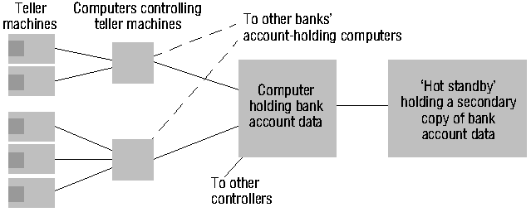
2.3 AUTOMATIC TELLER MACHINE NETWORK
Notes:
An automatic teller machine network enables bank customers to withdraw cash from their bank account.
Banks and building societies maintain large networks of teller machines.
Customer have high security, privacy and reliability requirements.
Customers may want to withdraw cash from their account through a ´foreign´ teller machine.
A front-end computer controls one or several tellers. It
transfers withdrawal requests to the computer of the account holder´s bank,
awaits the bank granting the request, and
therefore has to be interoperable with heterogeneous computer systems (Hang Seng Bank may have different account management systems than HongKong Bank and Bank of China).
Each bank has fault-tolerant systems to quickly recover from failures of their account holding computers. An example is the ´Hot standby´ computer which maintains a copy of the account database and can replace the main computer within seconds.

Slide 24
2.4 INTERNET
intranet

ISP



backbone
satellite link
desktop computer:
server:
network link:
Notes:
Internet is the largest distributed system in the world.

Slide 25
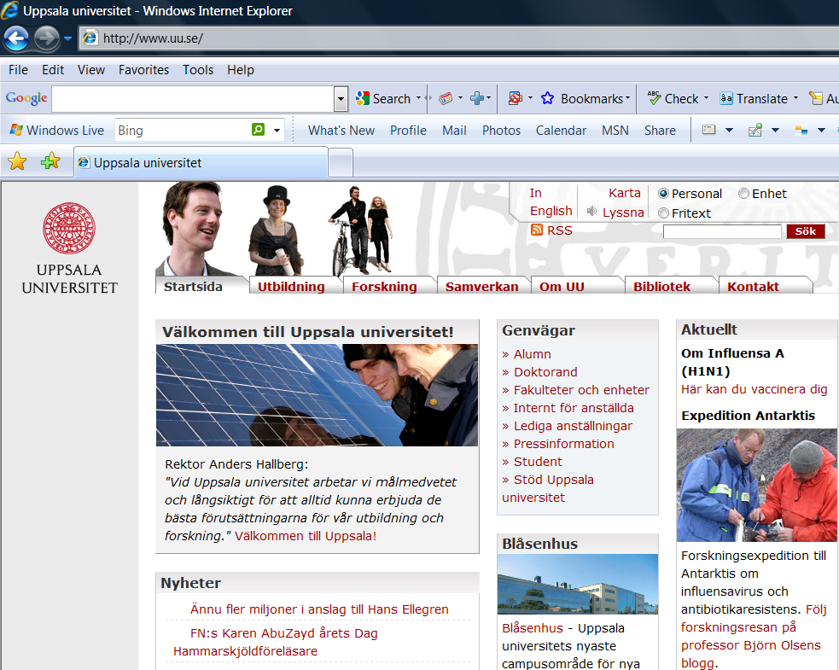
2.4.1 WORLD-WIDE-WEB
Notes:
World Wide Web is the largest software application running on Internet. It becomes the most popular distributed software application ever created.

Slide 26
2.4.2 WEB SERVERS AND WEB BROWSERS
http://www.google.comlsearch?q=lyu
www.google.com
Web servers
Browsers
www.uu.se
Internet
http://www.uu.se/
www.w3c.org
File system of
http://www.w3c.org/Protocols/Activity.html
www.w3c.org
Protocols
Activity.html
Notes:
A Web browser is a user interface to the world´s biggest distributed system, the Internet.
A Web page includes links to other Web pages. These links are specified as URLs.
An URL is the name of a protocol (ftp, http, etc.), the name of a site (gateway1.cse.cuhk.edu.hk) and the name of a file.
To follow a link to a remote Web page, your Web browser
talks to the local name server to resolve the symbolic site name into an IP address (137.189.89.153).
talks to the http daemon running on that web site and requests the delivery of the Web page addressed by the URL.
To obtain a file from a remote ftp site, your Web browser
resolves the site name with the local name server
talks to the ftp daemon running on that site and performs an anonymous login.
switches the daemon into an appropriate transfer mode and
obtains the file addressed by the file addressed in the URL.
To send an e-mail, your Web browser
opens a new dialog window where you can enter the addressee(s) and the e-mail text
talks to the local sendmail daemon to have it delivering the e-mail to the sendmail daemons on the sites of your addressees.

Slide 27
2.5 MOBILE AND UBIQUITOUS COMPUTING
Internet
Host intranet
GSM/GPRS
Home intranet
Wireless LAN
gateway
Mobile
phone
Printer
Laptop
Camera
Host site
Notes:
Mobile and ubiquitous computer extend the access of Internet and distributed system architecture from wire-line connections to wireless connections.

Slide 28
3. COMMON CHARACTERISTICS
Certain common characteristics can be used to assess distributed systems
  Heterogeneity
  Openness
  Security
  Scalability
  Failure Handling
  Concurrency
  Transparency
Notes:
Why do we bother about constructing distributed systems? Constructing a centralized system appears to be much easier!
Some properties of a distributed system cannot be achieved by a centralized system. It is worthwhile to keep these properties in mind during the design or assessment of a distributed system.
Heterogeneity: I can access all the documents that are available on the Internet, even though the documents are located in different type of machines.
Openness: I have credit cards from Hang Seng Bank and Wells Fargo Bank in U.S.A. and can use them at each others tellers. These banks, however, would never develop a common centralized teller system. It is because their systems are open and interoperable that I have this flexibility.
Security: I want to purchase products in e-Commerce. I don’t want other people to steal my credit card number.
Scalability: Distributed systems, such as the Internet, grow each day to accommodate more users and to withstand higher load. (Hong Kong stock trading broker is on-line and you can open accounts and do on-line trading from home PC).
Failure Handling: Two (distributed) account databases are managed by the bank to quickly recover from a break-down.
Concurrency: Multiple database users can concurrently access and update data in a distributed database system. The database system preserves integrity against concurrent updates and users perceive the database as their own copy. They are, however, able to see each others changes after they have been completed.
Transparency: When using a distributed system it appears to users as if it were centralized.

Slide 29
3.1 HETEROGENEITY
Variety and differences in
  Networks
  Computer hardware
  Operating systems
  Programming languages
  Implementations by different developers
Middleware as software layers to provide a programming abstraction as well as masking the heterogeneity of the underlying networks, hardware, OS, and programming languages (e.g., CORBA).
Mobile Code to refer to code that can be sent from one computer to another and run at the destination (e.g., Java applets and Java virtual machine).
Notes:
The Internet enables users to access services and run applications over a heterogeneous collection of computers and networks.
Heterogeneity applies to
Networks
Computer hardware
Operating systems
Programming languages
Implementations by different developers
Differences of heterogeneous components in a distributed system have to be resolved
Differences in data type representation regarding, for example, byte ordering of integers
Different APIs of different operating systems for the implementation of the Internet protocols
Different programming languages use different representations for characters and data structures such as arrays and records
Different programmers have to common standards for communication purpose
Middleware helps to solve the problems of heterogeneity. It also provides a uniform computational model for use by the programmers of servers and distributed applications.
Mobile code is used to be run on heterogeneous computers. To get it done, the virtual machine approach provides a way of making code executable on any hardware: the compiler for a particular language generates code for a virtual machine instead of a particular hardware order code.

Slide 30
MIDDLEWARE THAT MAINTAINS HETEROGENEITY
The Common Object Request Broker Architecture (CORBA) is a standard defined by the Object Management Group (OMG)
Enables software components written in multiple computer languages and running on multiple computers to work together.
A standard for distributing objects across networks so that operations on those objects can be called remotely.
CORBA is not associated with a particular programming language, and any language with a CORBA binding can be used to call and implement CORBA objects.

Slide 31
3.2 OPENNESS
Openness is concerned with extensions and improvements of distributed systems.
Detailed interfaces of components need to be published.
New components have to be integrated with existing components.
Differences in data representation of interface types on different processors (of different vendors) have to be resolved.
Notes:
Openness tries to address the following question: How difficult is it to extend and improve a system.
Most often functional extensions and improvements require new components to be added.
These components may have to use the services provided by existing components.
Hence, the static and dynamic properties of services provided by components have to be published in detailed interfaces.
The new components have to be integrated into existing components, so that the added functionality becomes accessible from the distributed system as a whole.
Components may not always be running on the same platforms. Hang Seng Bank, HongKong Bank, and Bank of China almost certainly do not have the same type of hosts, it´s quite likely they use different programming languages and have different networks. Still their automatic teller machines have to be integrated.
To achieve such an heterogeneous integration, often different data representation formats have to be integrated. If components running on a Windows-3.x PC have to be integrated with components running on a Sun SparcStation, short integers on the Sun have 64 bit, while they only have 16 bit on the PC. Some mainframes revert the order in which 2 byte numbers are stored, most don´t.

Slide 32
3.3 SECURITY
In a distributed system, clients send requests to access data managed by servers, resources in the networks:
  Doctors requesting records from hospitals
  Users purchase products through electronic commerce
Security is required for:
  Concealing the contents of messages: security and privacy
  Identifying a remote user or other agent correctly (authentication)
Notes:
Many needs for security exist for distributed systems for data secrecy and personal privacy.
Security is also required for authentication purpose.
Many challenges in security exist in modern distributed systems. Denial of service attack and mobile code security are two examples.

Slide 33
3.4 SCALABILITY
Adaptation of distributed systems to
  accommodate more users
  respond faster (this is the hard one)
Usually done by adding more and/or faster processors.
Components should not need to be changed when scale of a system increases.
Design components to be scalable!
Notes:
Centralized systems often create bottlenecks as soon as a certain number of users are reached.
Distributed systems can be built in a way that these bottlenecks are avoided.
Then new processors can be added to accommodate new users. The Internet grows every day by adding new sites.
Other internet sites are not affected by these additions. They do not have to be changed.
However, components in distributed systems have to be designed in a way that the overall system remains scalable.
Sometimes it is required to relocate components, i.e. to migrate them to new processors. Relocation is required to populate new processors with components and to remove a certain amount of load from existing processors.
Then it is important that no or only very little assumptions are made on the location of components, both within the component itself and also within other components that use the component. Otherwise these components having explicit location information have to be changed whenever a component is relocated.

Slide 34
3.5 FAILURE HANDLING (FAULT TOLERANCE)
Hardware, software and networks fail!
Distributed systems must maintain availability even at low levels of hardware/software/network reliability.
Fault tolerance is achieved by
  recovery
  redundancy
Notes:
Hardware, software and networks are not free of failures. They fail either because of software errors, failures in the supporting infrastructure (power-supply or air-conditioning), mis-use of their users or just because of aging hardware. The average life time of hard disks are between two and five years, much less than the average life-time of a distributed system.
Given that there are many processors in a distributed system, it is much more likely that one of them fails than it is that a centralized system fails.
Distributed system, therefore, have to be built in a way that they continue to operate, even in the presence of failures of some of its components.
A distributed system can even achieve a higher reliability than a centralized system if distribution and replication is exploited properly.
Two different means have to be deployed to achieve fault tolerance: recovery and redundancy.
Components that are able to recover from failures have been built in a way that they react in a controlled way if they rely on services of components that have failed.
Redundant hardware, software and data decreases the time that is needed after a failure to bring a system up again.

Slide 35
3.6 CONCURRENCY
Components in distributed systems are executed in concurrent processes.
Components access and update shared resources (e.g. variables, databases, device drivers).
Integrity of the system may be violated if concurrent updates are not coordinated.
  Lost updates
  Inconsistent analysis
Notes:
Components in distributed systems are executed concurrently. There may be many different people at different teller machines. Likewise, there are many different users working in a local area network.
While these components access shared resources, the resources have to be protected against integrity violations that may be introduced through concurrency.
As an example for a lost update, consider that you withdraw 50 dollars. This requires the bank´s account database to compute:
debitbalance = balance-50; /* Op1 */
balance = debitbalance; /* Op2 */
If a clerk in the bank credits a check of 100 dollars the following computation has to be done:
creditbalance = balance+100; /* Op3 */
balance = creditbalance; /* Op4 */
If these two modifications to your account are done concurrently the integrity of the account data may be violated in two ways:
1. your debit may not be recorded (bad luck for the bank) if the schedule is (Op1, Op3, Op2, Op4).
2. the credit of your check may not be recorded (bad luck for you) if the schedule is (Op3, Op1, Op4, Op2).
These situations have by all means to be avoided.
Concurrency control facilities (such as locking) are needed in almost any concurrent system.

Slide 36
3.7 TRANSPARENCY
Distributed systems should be perceived by users and application programmers as a whole rather than as a collection of cooperating components.
Transparency has different aspects.
These represent various properties that distributed systems should have.
Notes:
The complexity of distributed systems should be hidden from their users. They should not have to be aware whether the system they are using is centralized or distributed. Thus, it is transparent for the user that s/he is using a distributed system.
For the administrators of the system, however, this is not true. For them, it may well be important (e.g. during load balancing) to know which component resides on which machine.
To make life easier for an application programmer, s/he should also not have to be aware that s/he is using distributed components.
You have certainly developed a program on a CSE machine where you had to use the file system. You were able to use the same library for file access irregardless whether the files were stored on local or remote file systems. Most likely, you were storing files on remote disks, however, and you may even not have been aware of that. Thus distribution was both access and location transparent for you as an application programmer.
There are many aspects of transparency, which we will discuss now. Transparency is, in fact, orthogonal to the other characteristics that we have discussed so far and applies to most of them. We will, therefore, have a closer look now at access transparency, location transparency, concurrency transparency, replication transparency, failure transparency, mobility transparency, performance transparency and scaling transparency.

Slide 37
3.7.1 ACCESS TRANSPARENCY
It allows the same operations to be used to access local and remote resources.
The file distribution must be hidden from the clients.
A common set of actions should be available to access both remote and local files.
Applications for local files are to be designed such that they should be able to run on remote files as well.
Example: File system operations in NFS.
Example: Navigation in the Web.
Example: SQL Queries
Notes:
Access transparency means that the operations or commands that are used for accessing objects are identical irregardless whether local or remote data is being accessed.
Examples of access transparency are:
Users of UNIX NFS can use the same commands for copying, moving and deleting files irregardless whether the accessed files are local or remote.
Application programmers can use the same library calls to manipulate files on NFS.
Users of a web browser can navigate to another page by clicking on a hyperlink, irregardless whether the hyperlink leads to a local or a remote page.
Programmers of a database application can use the same SQL commands irregardless whether they are accessing a local or a remote database in a distributed relational database management system.

Slide 38
3.7.2 LOCATION TRANSPARENCY
Enables information objects to be accessed without knowledge of their location.
Example: File system operations in NFS
Example: Pages in the Web
Example: Tables in distributed databases
Notes:
Location transparency means that data can be accessed without knowing the physical position of the data.
Examples
Users of the network file system can access files by name and do not need to know whether the file resides on a local or a remote disk.
The same applies to application programmers, who can pass file names to library functions and need not worry about the physical location of the files.
Users of a Web browser need not be aware where the page physically resides. They can access initially pages by a URL and then can navigate further by URLs that are embedded in the web page.
Programmers of a relational database application do not need to worry where the tables physically reside. They can access tables by table name and need not worry about where the table is physically located. Their local database monitor will translate the names into physical location and have remote monitors transferring tables if a remote table should be accessed.

Slide 39
3.7.3 CONCURRENCY TRANSPARENCY
Enables several processes to operate concurrently using shared information objects without interference between them. The shareable items are all accessed at the same time.
Example: NFS
Example: Automatic teller machine network
Example: Database management system
Notes:
Enables several processes to concurrently access and update shared information without having to be aware that other processes may be accessing the information at the same time.
Examples:
Multiple users can access and update files on the same file system and they do not know about each other.
Concurrency is, however, not transparent for an application programmer using the file system. To avoid lost updates and inconsistent analysis, s/he has to explicitly lock files.
Users of an automatic teller machine need not be aware of the fact that other customers are using tellers at the same time and that bank clerks may be concurrently manipulating account balances.
Programmers of relational database applications typically need not worry about concurrency, but integrity against concurrent updates is typically preserved by the database management system (e.g. by two-phase locking).

Slide 40
3.7.4 REPLICATION TRANSPARENCY
Mobility Transparency lets a system or resources move around without disrupting user or software processes. It also bolsters the load balancing of any client that may be overburdened.
Enables multiple instances of information objects to be used to increase reliability and performance without knowledge of the replicas by users or application programs
Example: Distributed DBMS
Example: Mirroring Web Pages.
Notes:
Replication is the duplication of data on other hosts
Replication is used to increase the reliability of data accesses as well as the performance with which data is accessed and updated.
Replication transparency denotes the fact that neither users nor application programmers have to be aware about the replication of data.
Examples:
Tables in a distributed relational database may be replicated. However neither users, nor application programmers are aware that the tables are replicated and updates have to be propagated to the other replicas as well.
Often Web pages are replicated to increase performance of their retrieval and to have them available also in the presence of network failures. The SuperJanet gateway, for instance replicates pages from the US that are frequently accessed. Replication, however, is transparent for both Web surfers and Web page designers. A Web surfer does not see that the page is not being brought over the Atlantic (S/he may be surprised by the speed, however). A Web page designer can still refer to the US URL and need not take the mirror site into account.

Slide 41
3.7.5 FAILURE TRANSPARENCY
Enables the concealment of faults
Allows users and applications to complete their tasks despite the failure of other components.
Example: Database Management System
Notes:
Even though components in distributed systems may fail, it is important that users of the systems are not aware of these failures. Failure Transparency denotes this concealment of failures.
Failure transparency is rather difficult to achieve. It involves complete fault recovery.
As an example, consider the distributed database again. If the database has kept local replicates of remote data, users can continue to use the database, even though the remote data monitors have failed. The local data monitor has to detect the failure of remote monitors. Updates of local data then have to be buffered in the local replicate, inconsistencies have to be temporarily tolerated (as multiple sites may temporarily buffer updates). After the remote monitor has come up again, the buffered updates have to be incorporated into the remote databases and inconsistencies (if any) have to be reconciled.

Slide 42
3.7.6 MOBILITY TRANSPARENCY
Allows the movement of information objects within a system without affecting the operations of users or application programs
Example: NFS
Example: Web Pages
Notes:
Migration denotes the fact that software and/or data is moved to other processors.
Migration is transparent to users and application programmers if they do not have to be aware of the fact that software and/or data has moved.
Migration transparency is dependent on location transparency.
Examples:
If CSE decides to move file systems of the NFS (or parts thereof) to a different disk, you will not recognize that.
If CSE moves the department Web site to a different location in the file system, you will not recognize that because the URL http://www.cse.cuhk.edu.hk will be interpreted by the local http daemon.

Slide 43
3.7.7 PERFORMANCE TRANSPARENCY
Allows the system to be reconfigured to improve performance as loads vary.
Example: Distributed make.
Notes:
Performance Transparency denotes the fact that users and application programmers are not aware as to how the performance that a distributes system has is actually achieved.
Example: There is a variant of make that is capable of performing jobs (e.g. compiling a source module) on remote machines. Then complex systems can be compiled much quicker. It not only considers the different processors and their capabilities, but also their actual load. If it can choose from a set of processors, it will delegate it to the fastest processor that has the lowest load. In this way it achieves an even better performance. Programmers using make, however, do not see or choose which machine performs which job. The way how the actual performance is achieved is transparent for them.

Slide 44
3.7.8 SCALING TRANSPARENCY
Allows the system and applications to expand in scale without change to the system structure or the application algorithms.
Example: World-Wide-Web
Example: Distributed Database
Notes:
Scalability denotes the fact that the distributed system can be adjusted to accommodate a growing load / number of users.
Scaling the distributed system up is transparent if users and application programmers do not have to be changed.
Examples:
New Web sites can be added to the Internet, thus scaling the Internet up without existing sites having to change their set-up.
New network connections can be added in the Internet or existing connections are replaced with higher bandwidth connections to improve throughput. Existing Web sites do not have to be changed to benefit from this improvement.
In a distributed database, new hosts can be added to accommodate parts of the database. The allocation tables maintained by database monitors will have to be adjusted. Existing database schemas and applications, however, need not be changed.

Slide 45
4. BASIC DESIGN ISSUES
General software engineering principles include rigor and formality, separation of concerns, modularity, abstraction, anticipation of change, …
Specific issues for distributed systems:
  Naming
  Communication
  Software structure
  System architecture
  Workload allocation
  Consistency maintenance
Notes:
According to the Fundamentals of Software Engineering book by Ghezzi et. al., software engineering principles include (1) Rigor and Formality (2) Separation of Concerns (3) Modularity (4) Abstraction (5) Anticipation of Change (6) Generality and (7) Incrementality.
Specific issues need to be resolved for the design of software for distributed systems.

Slide 46
4.1 NAMING
A name is resolved when translated into an interpretable form for resource/object reference.
  Communication identifier (IP address + port number)
  Name resolution involves several translation steps
Design considerations
  Choice of name space for each resource type
  Name service to resolve resource names to comm. id.
Name services include naming context resolution, hierarchical structure, resource protection
Notes:
Name: names that can be interpreted by users or by programs
Identifier: names that can be interpreted or used only by programs. At each name translation step, a name or identifier is mapped to a lower-level identifier that can be used to specify a resource when communicating with some software component, until a communication id is produced that is acceptable to the communication subsystem, and that is used to transmit a request to a resource manager.
Names having some hierarchical structure
representing an internal hierarchic name space (/etc/passwd)
organizational hierarchy (cse.cuhk.edu.hk)
a flat set of numeric or symbolic identifier
advantages: each part of a name is resolved relative to a separate context, and the same name may be used with different meaning in different context
Names are always resolved relative to some context. Contexts are represented by name tables or databases. In the case of file systems, each directory represents a context. To resolve a name, we must supply the context and the name. A name service accepts requests for the translation of names or identifiers in one name space to identifier in some other space. It also handles name registration, deletion, and provides up-to-date information.
Naming schemes can be designed to protect the resources from unauthorized access. Each id is chosen so that it is hard to reproduce, and their client’s authority is being checked by the naming service. Ids which meet this requirement are known as capabilities.

Slide 47
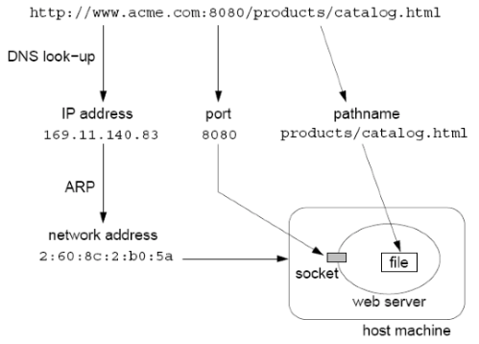
NAME RESOLUTION EXAMPLE
URL – http://www.acme.com:8080/products/catalog.html

Slide 48
4.2 COMMUNICATION
Separated components communicate with sending processes and receiving processes for data transfer and synchronization.
Message passing: send and receive primitives
  synchronous or blocking
  asynchronous or non-blocking
  Abstractions defined: channels, sockets, ports.
Communication patterns: client-server communication (e.g., RPC, function shipping) and group multicast
Notes:
Synchronization prevent sending or receiving process from continuing until the other process makes an action that frees it.
Each message-passing action involves the transmission by the sending process of a set of data values (a message) through a specified communication mechanism (a channel or port) and the acceptance by the receiving process of a message.
Synchronous (blocking) means that the sender waits after transmitting a message until the receiver has performed a receive operation.
Asynchronous (non-blocking) means that the message is placed in a queue of messages waiting for the receiver to accept them and the sending process can proceed immediately.
Distributed systems can be designed entirely in terms of message-passing, but there are certain useful communication patterns (collective of primitives for high-level operations).
Client-server communication model is for service provision: 1. Transmission of a request from a client to a server; 2. Execution of the request by the server; 3. Transmission of a reply to the client.
Function shipping: the server acts as an execution environment and interpreter for programs, and clients transmit sequences of instructions for interpretation (e.g., PostScript files sent to printer).
Multicasting: sending a message to the members of a specified group of processes. Multicasting examples: locating an object, fault tolerance, and multiple update.

Slide 49
4.3 SOFTWARE STRUCTURE
Layers in centralized computer systems:
Applications
Middleware
Operating system
Computer and Network Hardware
Notes:
Middleware provides run-time support for programming language, such as interpreters and libraries
OS is the main system software to manage basic resources and to provide user and application services:
Basic resource management:
- memory allocation and protection
- process creation and processor scheduling
- peripheral device handling
User and application services:
- user authentication and access control (e.g., login facilities)
- file management and file access facilities
- clock facilities

Slide 50
4.3 SOFTWARE STRUCTURE
Layers and dependencies in distributed systems:
Applications
Open
services
Distributed programming
support
Open system kernel services
Computer and network hardware
Notes:
Kernel only perform basic resource management with the addition of inter-process communication
A new class of software component called open services to provide all other shared resources and services.
Kernels are not designed to be modified routinely. Any services that do not require privileged access to the kernels’ code and data or the hardware of the computer need not be included in the kernel.
A shared horizontal line signified that services provided by the box below the line are directly used by the components above it. E.g., application program may use OS kernel services, distributed programming support and open services.
Micro-kernels: the kernels that provide the smallest possible set of services and resources on which the remaining services required can be built. Typically this basic set of services includes a process abstraction and a basic communication service.
Open services: The distinction between kernel services and open services is made because kernel cannot be open, as they must enforce their own protection against run-time modification. Openness means that distributed systems can be configured to the particular needs of a given community of users or set of applications.
Distributed programming support includes run-time support for language facilities that allow programs written in conventional languages to work together.

Slide 51
4.4 SYSTEM ARCHITECTURES
Client-Server
Peer-to-Peer
Services provided by multiple servers
Proxy servers and caches
Mobile code and mobile agents
Network computers
Thin clients and mobile devices

Slide 52
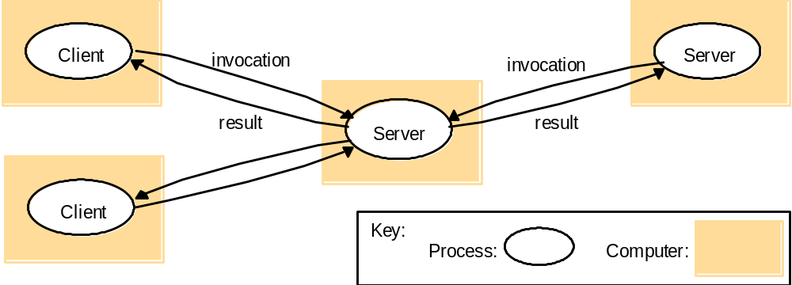
4.4.1 CLIENTS INVOKE INDIVIDUAL SERVERS

Slide 53
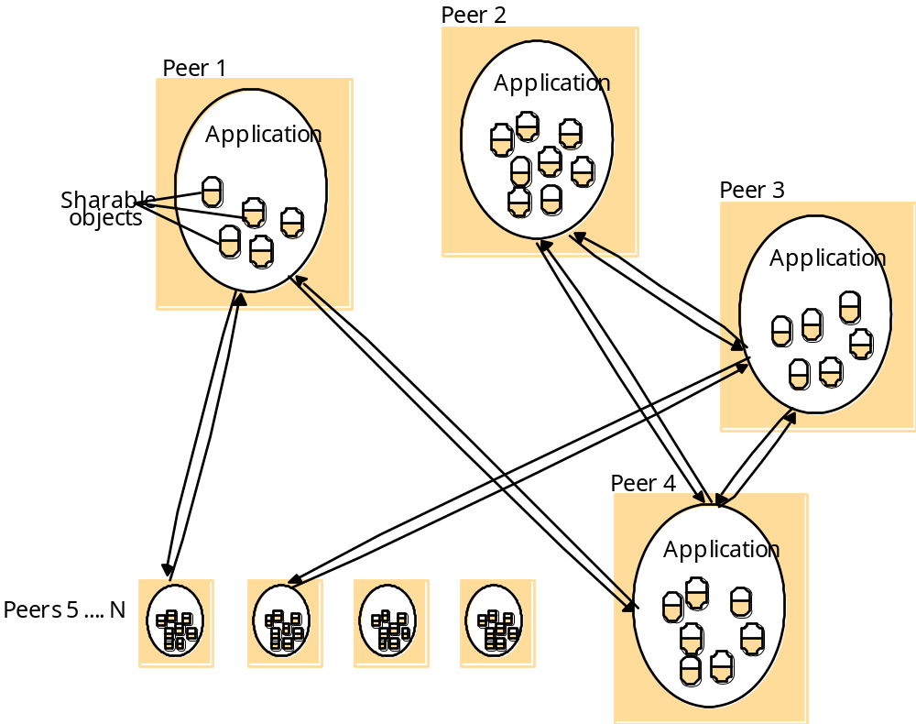
4.4.2 PEER-TO-PEER SYSTEMS

Slide 54
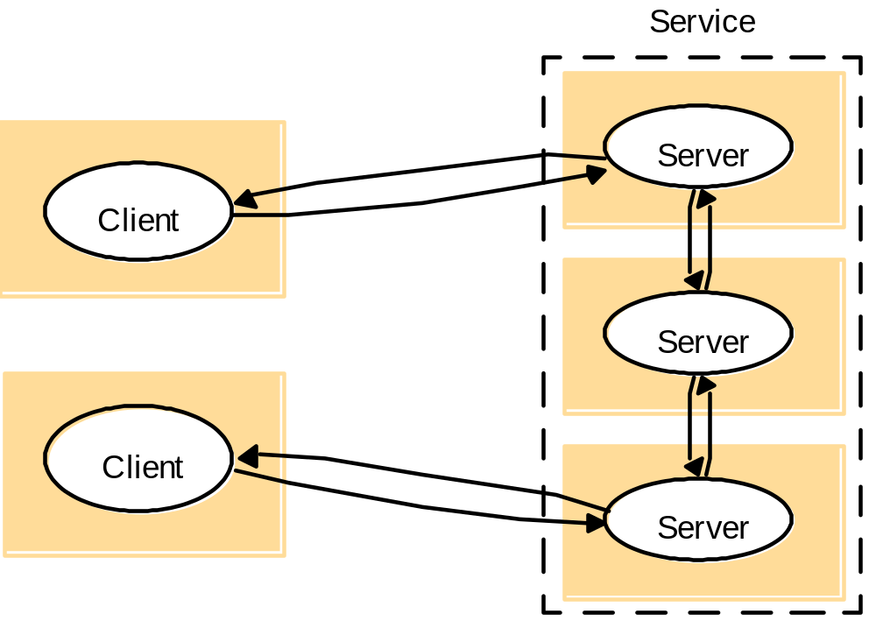
4.4.3 A SERVICE BY MULTIPLE SERVERS
Notes:
Load sharing
Redundancy

Slide 55
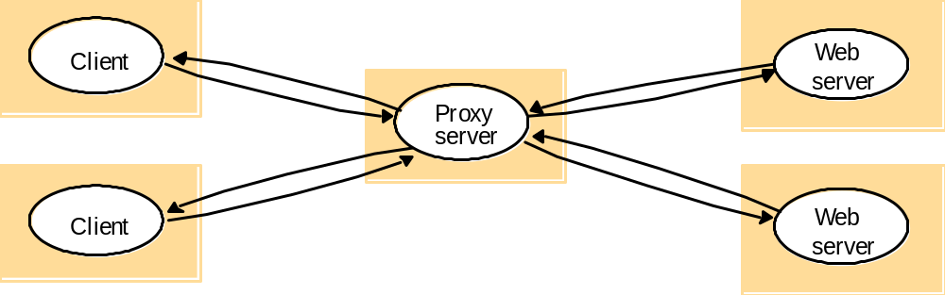
4.4.4 WEB PROXY SERVER

Slide 56
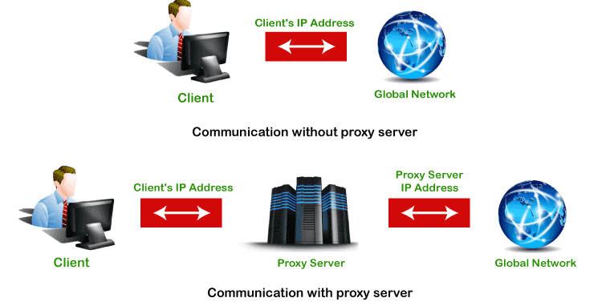
It improves the security and enhances the privacy of the user.
It hides the identity (IP address) of the user.
It controls the traffic and prevents crashes.
Also, saves bandwidth by caching files and compressing incoming traffic.
Protect our network from malware.
Allows access to the restricted content.

Slide 57
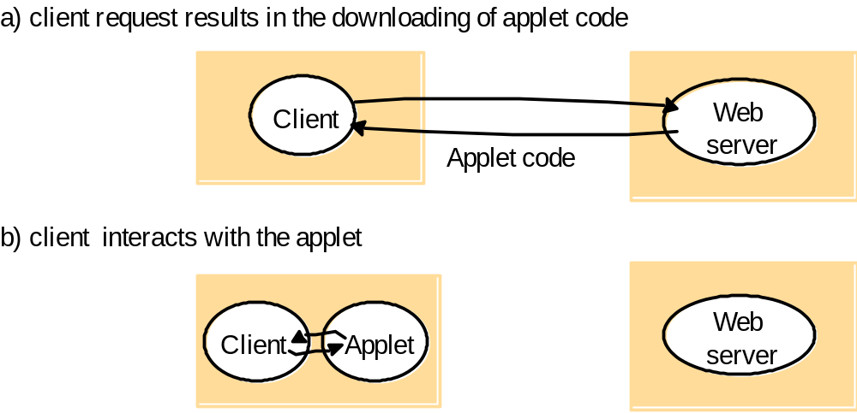
4.4.5 WEB APPLETS

Slide 58
4.4.6 THIN CLIENTS AND COMPUTE SERVERS
Compute server
Network computer or PC
Thin
network
Application
Client
Process

Slide 59
5. SUMMARY
Definitions of distributed systems and comparisons to centralized systems.
The characteristics of distributed systems.
The eight forms of transparency.
The basic design issues.
Read Chapter 1 and Chapter 2 of the textbook.
Notes:
Read textbook Chapter 1 and Chapter 2.

